Slide 1
Deep Unsupervised Learning using Non-equilibrium Thermodynamics
ICML 2015
Jascha Sohl-Dickstein, Eric A. Weiss, Niru Maheswaranathan, Surya Ganguli
Presented by Beomsoon Park
C&I LAB

Slide 2
Contents
Introduction
Background
Algorithm
Results
C&I LAB

Slide 3
Introduction
C&I LAB

Slide 4
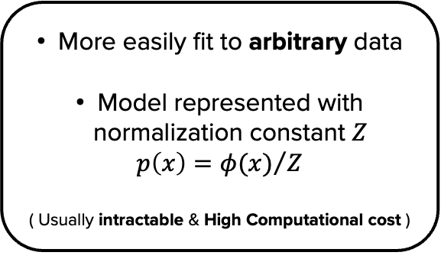
Introduction
Tractability vs Flexibility
Tractability
Flexibility
Analytically evaluable
( Available on a few dataset )
Easily fit to dataset with simple structure
More easily fit to arbitrary data
Model represented with normalization constant $Z$
$p\left(x\right)={φ(x)}/Z$
( Usually intractable & High Computational cost )
C&I LAB

Slide 5
Introduction
Diffusion probabilistic model
Extreme Flexibility in model structure
Exact Sampling Availability
Easy Multiplication with other distributions
Cheaply Evaluable
C&I LAB

Slide 6
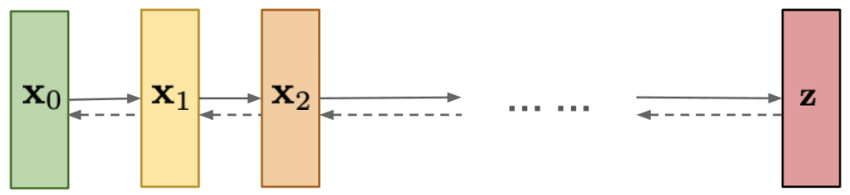
Introduction
Diffusion probabilistic model
Forward Trajectory
Data
Distribution
Noise
Tractable
Reverse Trajectory
https://lilianweng.github.io/posts/2021-07-11-diffusion-models/
C&I LAB

Slide 7

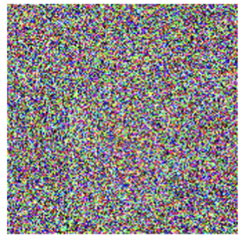
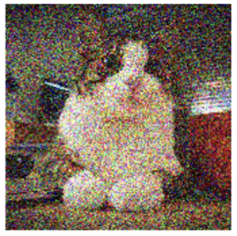
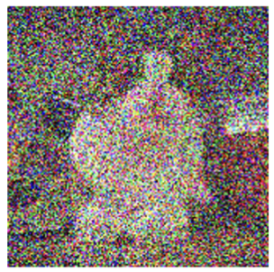
Introduction
Forward Diffusion Process
Forward Trajectory
Gaussian Noise
Data
Distribution
Noise
Tractable
https://lilianweng.github.io/posts/2021-07-11-diffusion-models/
C&I LAB

Slide 8
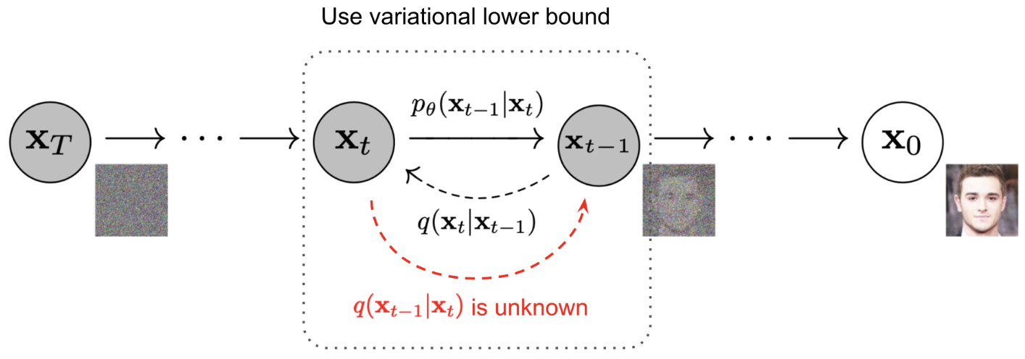
Introduction
Reverse Diffusion Process
Target to be trained
https://lilianweng.github.io/posts/2021-07-11-diffusion-models/
C&I LAB

Slide 9
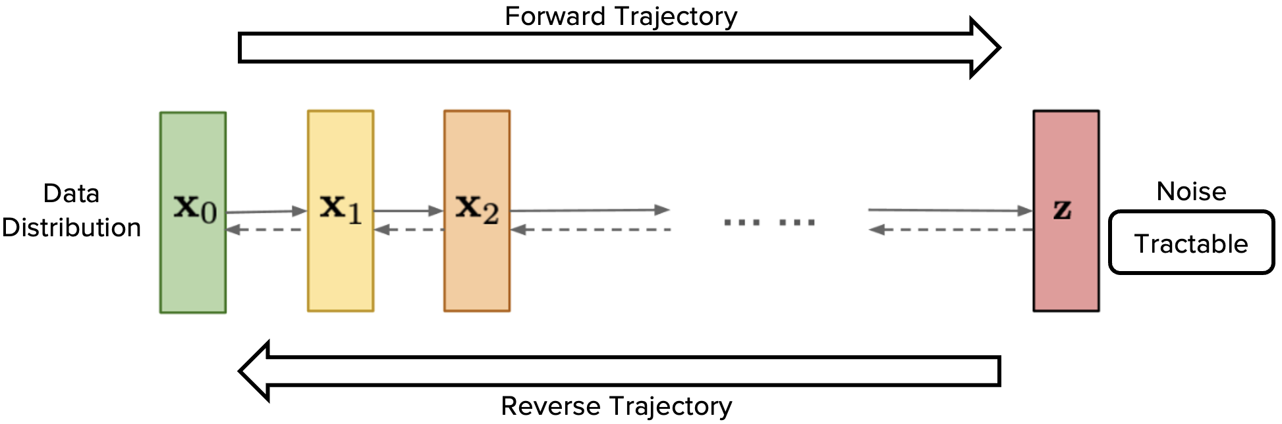
Introduction
Tractability & Flexibility in suggested model
Tractability
Diffusion process → Estimate small perturbation : More tractable than normalizing constant
Flexibility
Diffusion process always exists for any smooth distribution → Flexible model
C&I LAB

Slide 10
Background
C&I LAB

Slide 11
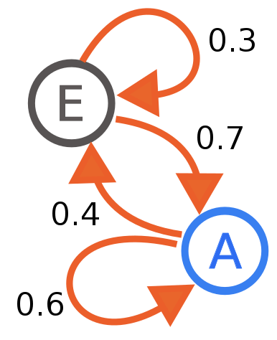
Background
Markov process
Markov Chain
Markov Property
The future state only depends
on the current state
C&I LAB

Slide 12
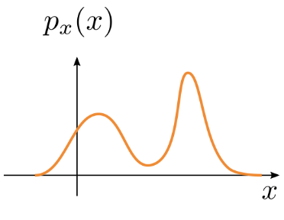
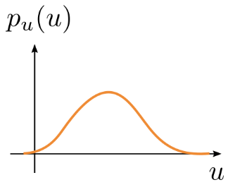
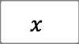
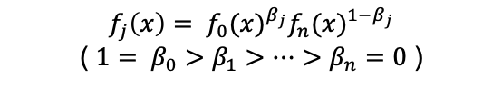
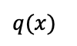
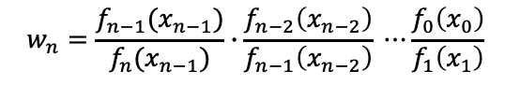
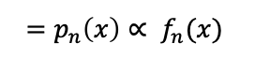
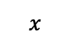
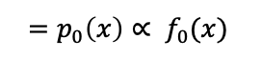
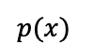
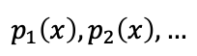
Background
Annealed Importance Sampling
$$=p_{0}\left(x\right)∝ f_{0}(x)$$
$$=p_{n}\left(x\right)∝ f_{n}(x)$$
Importance Weight
$$p(x)$$
$$q(x)$$
$$w_{n}=\frac{f_{n−1}(x_{n−1})}{f_{n}(x_{n−1})}∙\frac{f_{n−2}\left(x_{n−2}\right)}{f_{n−1}\left(x_{n−2}\right)} ⋯\frac{f_{0}\left(x_{0}\right)}{f_{1}\left(x_{1}\right)}$$
$$p_{1}\left(x\right), p_{2}\left(x\right), …$$
$$f_{j}\left(x\right)= {f_{0}(x)}^{β_{j}}{f_{n}(x)}^{1−β_{j}}$$
( $1= β_{0}>β_{1}>⋯>β_{n}=0$ )
$$x$$
$$x$$
Intractable
Distribution
Approximate intractable probability distribution utilizing importance weight
https://dfdazac.github.io/02-flows.html
C&I LAB

Slide 13
Background
Theoretical background knowledge
Gaussian Diffusion Process
Langevin Dynamics
Stochastic differential equation → Modeling the dynamics of particles and system
Randomness is introduced by using the term modeled with Gaussian Diffusion Process
https://en.wikipedia.org/wiki/Langevin_dynamics
C&I LAB

Slide 14
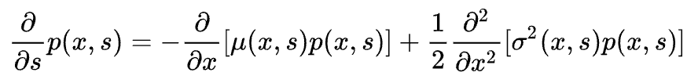
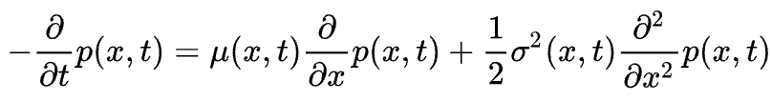
Background
Theoretical background knowledge
Gaussian Diffusion Process
Kolmogorov Forward Equation
Kolmogorov Backward Equation
Gaussian Diffusion Process
Characterize continuous-time continuous-state Markov process
Diffusion Process for each direction → Same functional form
https://en.wikipedia.org/wiki/Kolmogorov_backward_equations_(diffusion)
C&I LAB

Slide 15
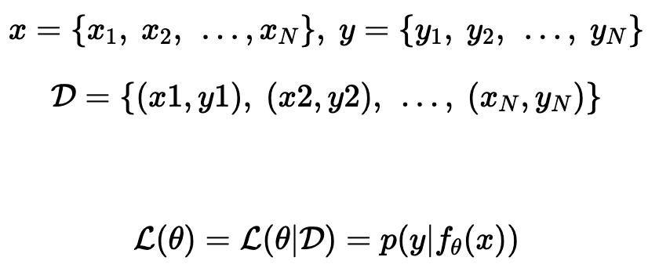
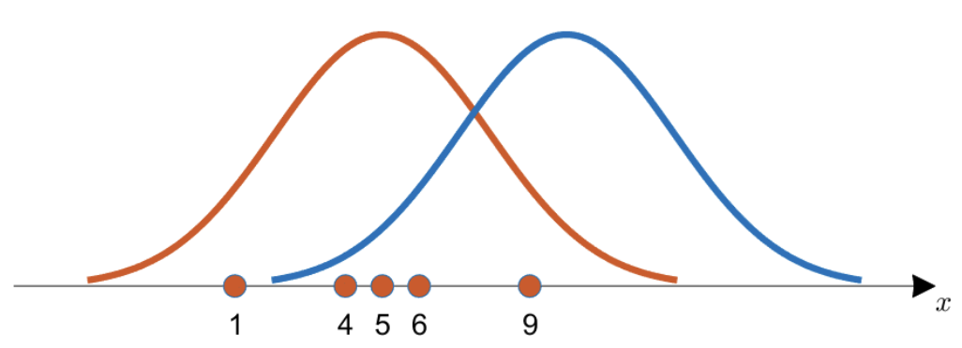
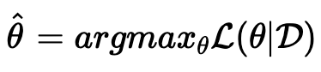
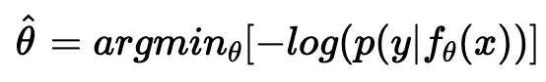
Background
Maximum log likelihood
Which distribution is more appropriate for the observed data much better?
https://aigong.tistory.com/369
C&I LAB

Slide 16
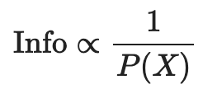
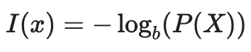
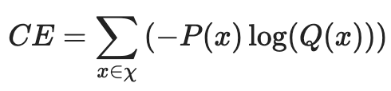
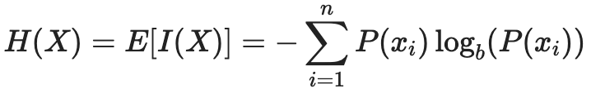
Background
Entropy & Cross Entropy
The amount of information
The amount
representing the unexpected response
Entropy
https://angeloyeo.github.io/2020/10/27/KL_divergence.html
C&I LAB

Slide 17
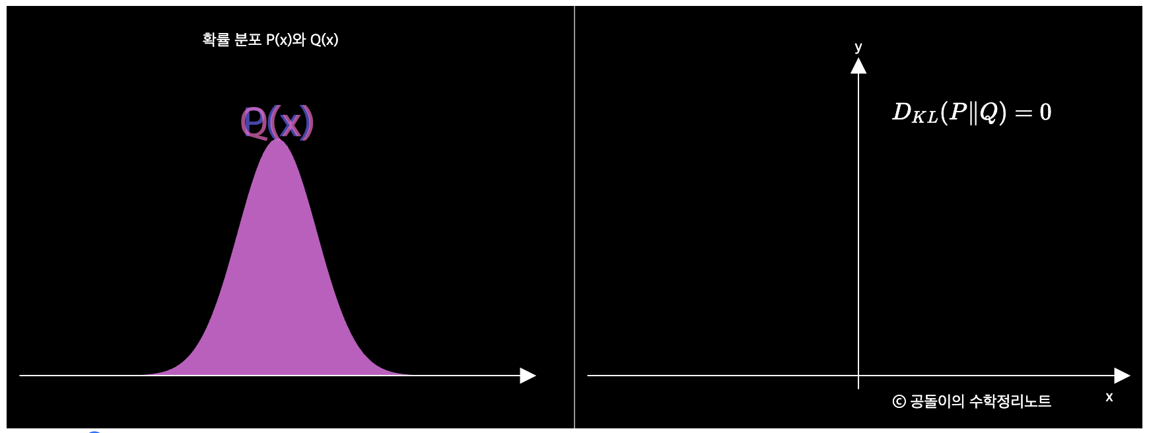
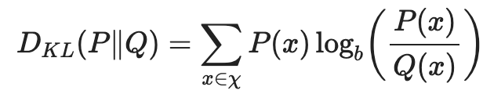
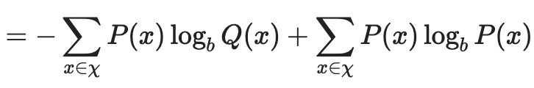
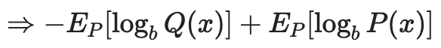
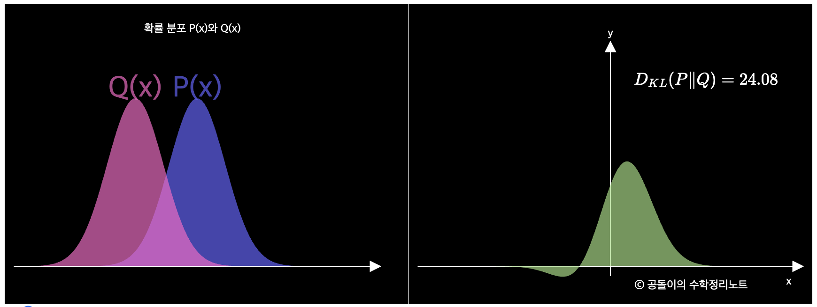
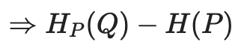
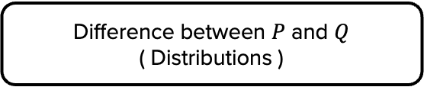
Background
KL Divergence
Difference between $P$ and $Q$
( Distributions )
https://angeloyeo.github.io/2020/10/27/KL_divergence.html
C&I LAB

Slide 18
Algorithm
C&I LAB

Slide 19
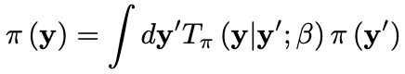
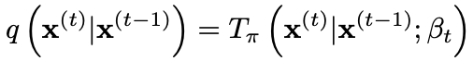
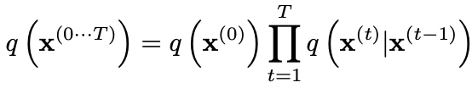
Algorithm
Forward Trajectory
Diffusion Rate
Tractable
Distribution
Markov Diffusion Kernel
Gaussian Diffusion
Gaussian Distribution with identity-covariance
C&I LAB

Slide 20
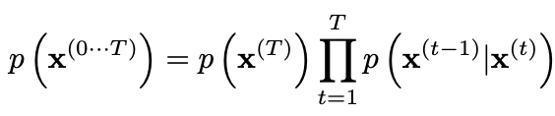
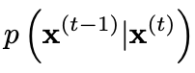
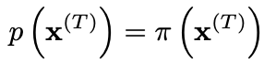
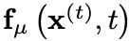
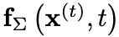
Algorithm
Reverse Trajectory
Target for training
C&I LAB

Slide 21
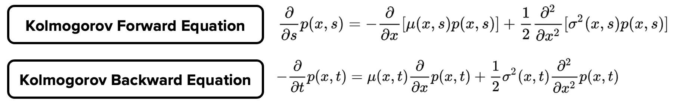

Algorithm
Gaussian Diffusion Process in Reverse Trajectory
Kolmogorov Forward
& Backward Equation
Continuous Diffusion → Infinitesimal step
Identical functional form
$q(x_{t}|x_{t−1})$ : Gaussian Distribution
→ $q(x_{t−1}|x_{t})$ : Gaussian Distribution
Sufficient to only find appropriate mean and covariance
C&I LAB

Slide 22
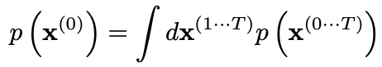
Algorithm
Model Probability
“Intractable”
Approximation formula
with the help of Annealed Importance Sampling
C&I LAB

Slide 23
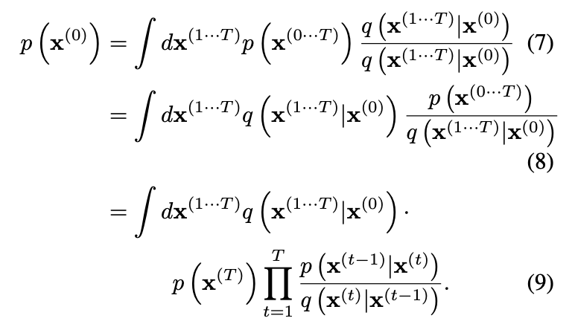
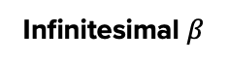
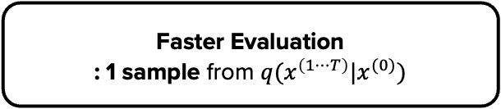
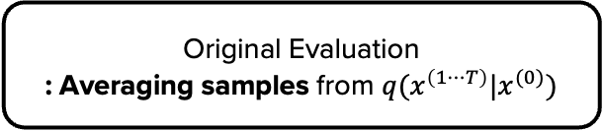
Algorithm
Model Probability
Original Evaluation
: Averaging samples from $q(x^{\left(1⋯T\right)}|x^{(0)})$
Same distribution form for each trajectory
Infinitesimal $β$
Faster Evaluation
: 1 sample from $q(x^{\left(1⋯T\right)}|x^{(0)})$
C&I LAB

Slide 24


Algorithm
Model Training
Lower bound provided by Jensen’s Inequality
Maximize log likelihood
C&I LAB

Slide 25


Algorithm
Model Training
Cross Entropy
(Exact Value)
C&I LAB

Slide 26


Algorithm
Model Training
Omit the final step of reverse trajectory
C&I LAB

Slide 27

Algorithm
Model Training
Markov process
Bayes’ Rule
C&I LAB

Slide 28

Algorithm
Model Training
Conditional Entropy
C&I LAB

Slide 29

Algorithm
Model Training
C&I LAB

Slide 30


Algorithm
Setting the Diffusion Rate $β_{t}$
Optimal $β_{t}$ → Critical Role in model improvement
Variance $β_{1}$ → Fixed to small constant
(Prevent overfitting)
Variance $β_{2⋯T}$
→ Learning through gradient ascent on $K$
Variance $β_{1⋯T}$ → “Frozen Noise” while..
1. Sampling from $q(x^{\left(1⋯T\right)}|x^{(0)})$ / 2. Computing partial derivatives of $K$
C&I LAB

Slide 31


Algorithm
Multiplying Distributions & Computing Posteriors
Computing Posteriors
Signal Denoising, Inpainting
$$\tilde{p}\left(x^{(0)}\right)∝p\left(x^{(0)}\right)∙r(x^{(0)})$$
Bounded positive function
Unlike other models,
$r(x^{(0)})$ is treated as a small perturbation for each diffusion process
& exactly multiplied at every diffusion step
C&I LAB

Slide 32




Algorithm
Modified Marginal Distribution
Revised reverse trajectory
$$\tilde{p}\left(x^{\left(T\right)}\right)=\frac{1}{\tilde{Z_{t}}}p\left(x^{(T)}\right)r(x^{(T)})$$
$$\tilde{p}\left(x^{\left(0\right)}\right)$$
Perturbed $t$th intermediate distribution
$\tilde{Z_{t}}$ : Normalizing constant
C&I LAB

Slide 33


Algorithm
Modified Diffusion Step
Original equilibrium condition
Markov kernel for reverse diffusion process
Modified equilibrium condition
How does this equation hold?
C&I LAB

Slide 34

Algorithm
Modified Diffusion Step
C&I LAB

Slide 35


Algorithm
Modified Diffusion Step
Normalizing constant for perturbed Markov kernel
C&I LAB

Slide 36




Algorithm
Modified Diffusion Step
Each diffusion step : Relatively small variance for $r(x^{(t)})$
$\frac{r(x^{(t)})}{r(x^{(t+1)})}$ : Small Perturbation to $p(x^{t}|x^{t+1})$
$$0≤β_{t}≤1$$
Only affect $μ$ of $p(x^{t}|x^{t+1})$
C&I LAB

Slide 37


Algorithm
Applying $r(x^{(t)})$
Sufficiently smooth $r(x^{(t)})$
Small Perturbation to $p(x^{t}|x^{t+1})$
Identical functional form with different mean
C&I LAB

Slide 38



Algorithm
Choosing $r(x^{(t)})$
Basically, $r(x^{(t)})$ should change very slowly
Remain Constant
Slow Change, but no contribution to the initial state
Make sure drawing initial sample from $\tilde{p}(x^{(T)})$
C&I LAB

Slide 39


Algorithm
Entropy of Reverse Process
Upper and lower bound of $H_{q}(X^{\left(t−1\right)}|X^{\left(t\right)})$
Upper and lower bound of conditional entropy
& log likelihood can be derived
Forward Process : Known
C&I LAB

Slide 40


Algorithm
Entropy of Reverse Process
Upper and lower bound of $H_{q}(X^{\left(t−1\right)}|X^{\left(t\right)})$
Idea
: Maximum entropy distribution (Equilibrium status)
Upper bound of $H_{q}(X^{\left(t−1\right)}|X^{\left(t\right)})$
C&I LAB

Slide 41

Algorithm
Entropy of Reverse Process
Upper and lower bound of $H_{q}(X^{\left(t−1\right)}|X^{\left(t\right)})$
Idea
: Additional steps in Markov chain do not decrease the conditional entropy of the initial state
Lower bound of $H_{q}(X^{\left(t−1\right)}|X^{\left(t\right)})$
C&I LAB

Slide 42

Algorithm
Entropy of Reverse Process
Upper and lower bound of $H_{q}(X^{\left(t−1\right)}|X^{\left(t\right)})$
Upper and lower bounds only depend on $q(x^{\left(1⋯T\right)}|x^{(0)})$ → Analytically Computable
C&I LAB

Slide 43
Results
C&I LAB

Slide 44

Results
2-d Swiss roll
C&I LAB

Slide 45

Results
Binary Heartbeat Distribution
Binomial Distribution is used for this experiment
C&I LAB

Slide 46

Results
CIFAR-10
(a) Holdout data (CIFAR-10)
(b) Corrupted with Gaussian noise
(c) Denoised images
(d) Samples generated by diffusion model
C&I LAB

Slide 47


Results
Dead Leaf & Bark
C&I LAB

Slide 48



Results
Log likelihood
$∗ L_{null}$ : log likelihood of $π(x^{\left(0\right)})$
$∗K−L_{null}$ : Improvement relative to isotropic Gaussian
C&I LAB

Slide 49
Thank you
C&I LAB

